Slide 1
Concurrency Control
Advanced databases lecture 2

Slide 2
Content
Concurrency Control
Locking methods
Deadlock + Livelocks
Timestamping methods
Optimistic techniques

Slide 3
Locking
A lock is a variable associated with data items describing the status of the item with respect to operations that can be performed on it.
Locking is a procedure used to control concurrent access to data.
When a transaction is attempting to access a data item in the database, a lock may deny it access

Slide 4
Locking Rules
If a transaction has shared lock on an item, can read but not update item.
If transaction has exclusive lock on item, can both read and update item.
Reads cannot conflict, so more than one transaction can hold shared locks simultaneously on same item.
Exclusive lock gives transaction exclusive access to that item.

Slide 5
Locking Rules
Some systems allow transaction to upgrade read lock to an exclusive lock, or downgrade exclusive lock to a shared lock.
Use of locks in transactions does not guarantee serializability of schedules by themselves.
Problem is that transactions release locks too soon, resulting in loss of total isolation and atomicity.

Slide 6
Two-Phase Locking (2PL)
To guarantee serializability, need an additional protocol concerning the positioning of lock and unlock operations in every transaction.
2PL: Transaction follows 2PL protocol if all locking operations precede first unlock operation in the transaction.
Two phases for transaction:
Growing phase - acquires all locks but cannot release any locks.
Shrinking phase - releases locks but cannot acquire any new locks.

Slide 7
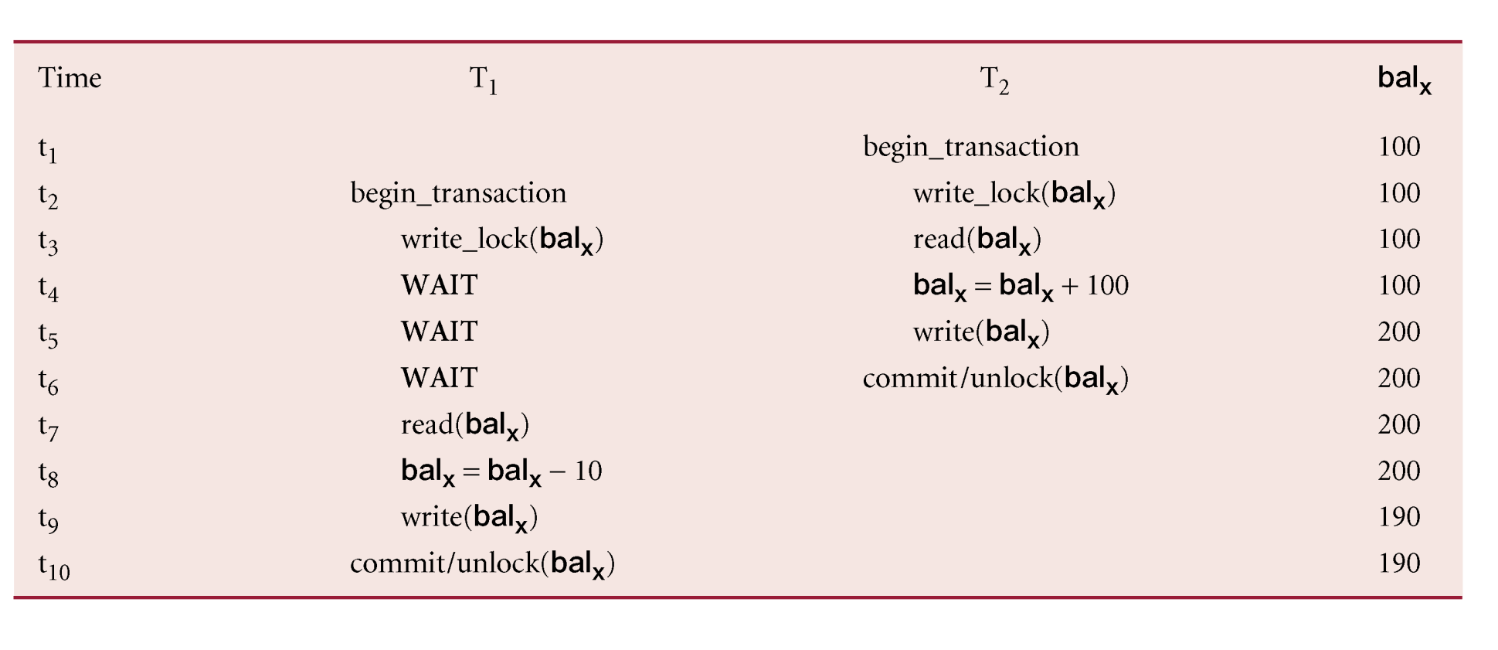
Preventing Lost Update Problem using 2PL

Slide 8
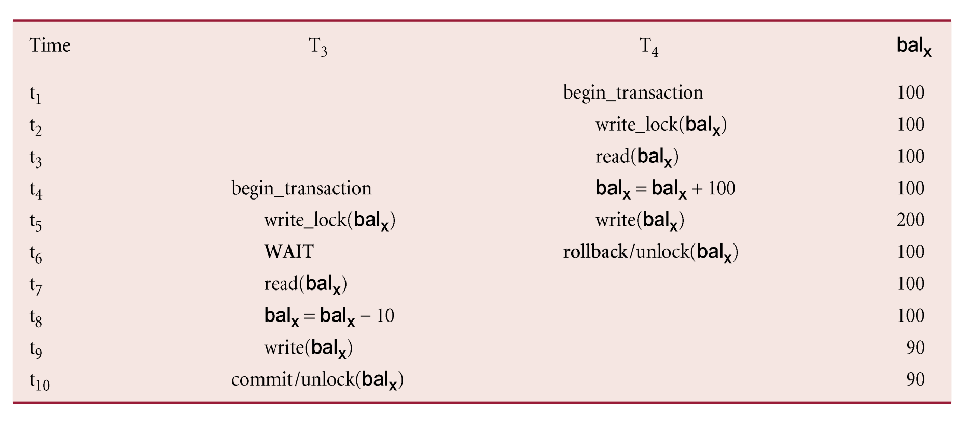
Preventing Uncommitted Dependency Problem using 2PL

Slide 9
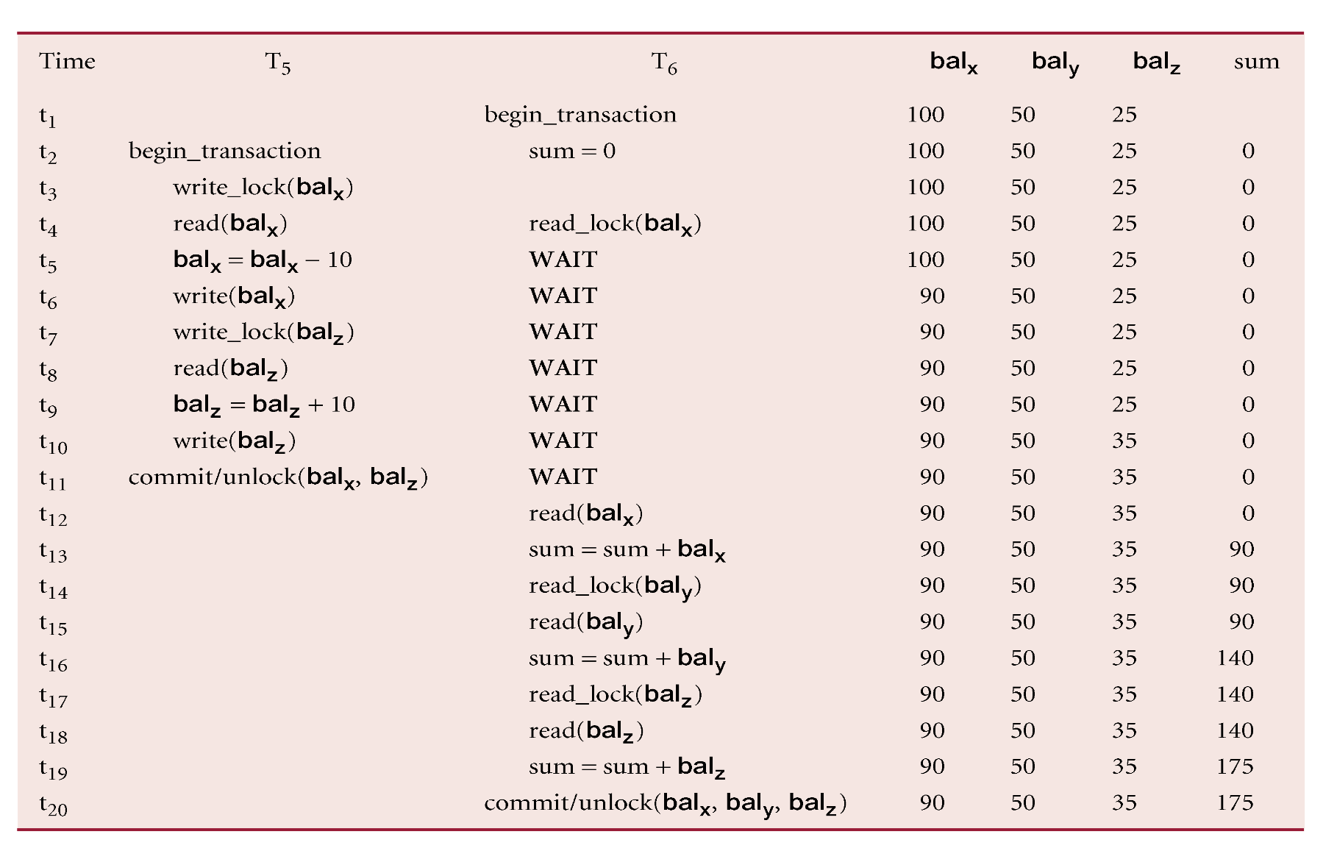
Preventing Inconsistent Analysis Problem using 2PL

Slide 10
Two-Phase Locking (2PL)
If every transaction in a schedule follows 2PL, the schedule is guaranteed to be conflict serializable.

Slide 11
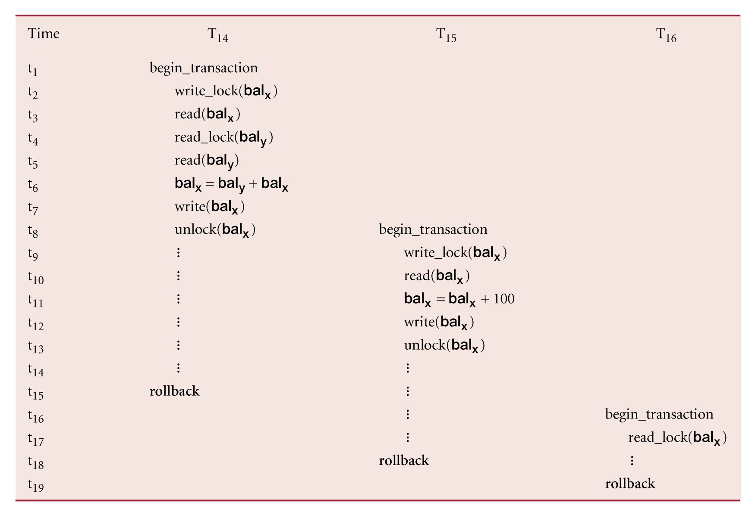
2PL issue - Cascading Rollback

Slide 12
Cascading Rollback
Transactions conform to 2PL.
T₁₄ aborts.
Since T₁₅ is dependent on T₁₄, T₁₅ must also be rolled back. Since T₁₆ is dependent on T₁₅, it too must be rolled back.
This is called cascading rollback.
To prevent this with 2PL, leave release of all locks until end of transaction.
This is termed rigorous 2PL.

Slide 13
2 Phase Locking (2PL) issues
Two problems can arise with 2PL:
Livelock
Deadlock

Slide 14
Livelock
Livelock is a situation where the transaction is left in a wait state indefinitely, unable to acquire new locks, although the DBMS itself is not in deadlock.
This can happen if the waiting algorithm for transactions is unfair.
To avoid livelock a priority system can be used, whereby the longer a transaction has to wait, the higher its priority for obtaining locks e.g. A first-in-first-out queue.
Notes:
First come first serve (like a real-world queue) is fair but often not optimal for making real world systems
Shortest job first – not fair but often more optimal in response time than first come first serve
Highest response ratio often best balance:
Response ratio = waiting time / service time

Slide 15
Deadlock
Conditions required for deadlock:
Mutual exclusion: at least one resource must be held in a non-sharable mode.
Hold and wait: a process must have at least one resource and be waiting for more.
No Preemption: resource cannot be preempted. Resources not released until process does so voluntarily.
Circular wait: there must exist a set of N waiting processes such that each P0 waits for P1, P1 waits for P2. . . And Pn waits for P0 .

Slide 16
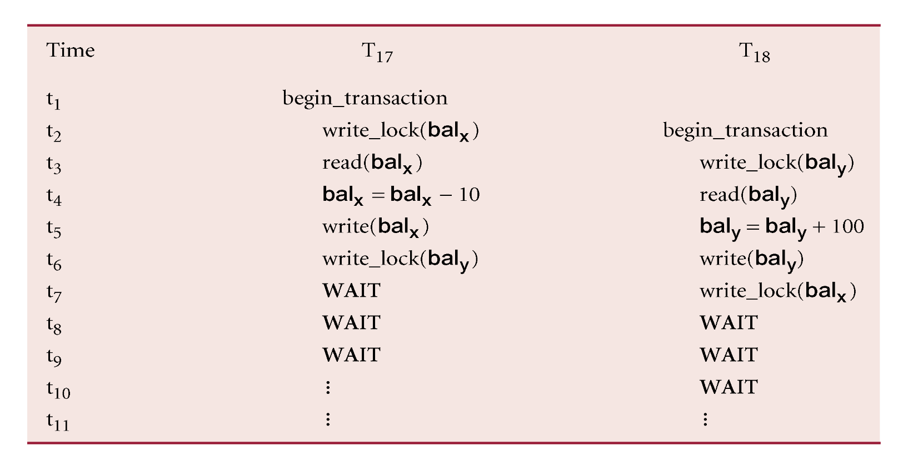
Deadlock
When two (or more) transactions are each waiting for locks held by the other to be released.

Slide 17
Deadlock
Only one way to break deadlock: abort one or more of the transactions.
Deadlock should be transparent to user, so DBMS should restart transaction(s).
Three general techniques for handling deadlock:
Timeouts.
Deadlock prevention.
Deadlock detection and recovery.

Slide 18
Deadlock Solution - Timeouts
Transaction that requests lock will only wait for a system-defined period of time.
If lock has not been granted within this period, lock request times out.
In this case, DBMS assumes transaction may be deadlocked, even though it may not be, and it aborts and automatically restarts the transaction.

Slide 19
Deadlock Solution – deadlock prevention
DBMS looks ahead to see if transaction would cause deadlock and never allows deadlock to occur.
Could schedule transactions using transaction timestamps, for example:
Wait-Die - only an older transaction can wait for younger one, otherwise transaction is aborted (dies) and restarted with same timestamp…

Slide 20
Deadlock Solution – deadlock prevention
Break Hold-and-wait condition:
Conservative 2PL: Require processes to request all resources at once – can lead to starvation
Or release existing resources before requesting more – in a database this could result in cascading rollback.

Slide 21
Deadlock Solution – detection and recovery
DBMS allows deadlock to occur but uses special algorithms to detect it and break/resolve it.
Algorithms assume deadlock is rare and checks execute at regular intervals to see if it present
Choice of time interval is important and can be dynamically modified:
Too small then execution of algorithm may be a considerable processing overhead
Too large then deadlock may exist undetected for prolonged periods of time

Slide 22
Deadlock Solution – detection and recovery
Algorithms will usually construct a wait-for graph (WFG) at regular intervals, showing transaction dependencies.
Wait-for graph (WFG) is constructed as follows:
Create a node for each transaction.
Create edge T_{i} -> T_{j}, if T_{i} waiting to lock item locked by T_{j}.
Deadlock exists if and only if the WFG contains cycle.

Slide 23
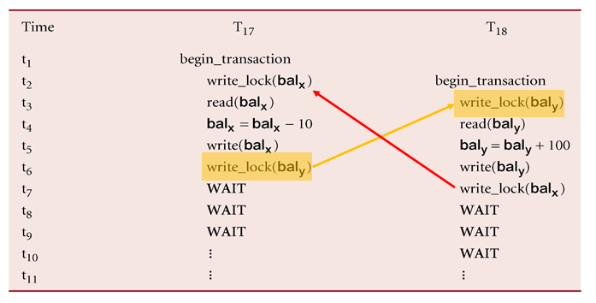
Deadlock Solution – detection and recovery
Construct graph:
T17
T18

Slide 24
Deadlock Solution – detection and recovery
Issues:
Choice of deadlock victim.
How far to roll back a transaction.
Avoiding Starvation.

Slide 25
Detection and recovery issues- Starvation
Starvation can occur when the same transaction is always chosen as the victim and thus it can never complete.
Starvation is very similar to livelock.
Starvation can be avoided by the DBMS maintaining a count of the number of times a transaction has been selected as the victim.
When the count reaches a defined upper limit, a different criterion is used to choose a victim.

Slide 26
Timestamping
Timestamp: A unique identifier created by DBMS that indicates relative starting time of a transaction.
Can be generated by using system clock at time transaction started, or by incrementing a logical counter every time a new transaction starts.

Slide 27
Timestamping
Transactions ordered globally so that older transactions, transactions with smaller timestamps, get priority in the event of conflict.
Conflict is resolved by rolling back and restarting transaction.
No locks so no deadlock.

Slide 28
Timestamping
If a transaction wants to read/write, that will proceed only if last update on that data item was carried out by an older transaction.
Otherwise, a transaction requesting read/write is restarted and given a new timestamp.
Also we can have timestamps for data items:
read-timestamp - timestamp of last transaction to read item;
write-timestamp - timestamp of last transaction to write item.

Slide 29
Basic Timestamping – Read(x)
Consider a transaction T with timestamp ts(T).
ts(T) < write_timestamp(x)
x already updated by younger (later) transaction.
Transaction must be aborted and restarted with a new timestamp….possible data inconsistency
Otherwise, ts(T) >= write_timestamp(x), operation is accepted and executed.

Slide 30
Basic Timestamping – Write(x)
ts(T) < read_timestamp(x)
x already read by younger transaction.
Roll back transaction and restart it using a later timestamp.
ts(T) < write_timestamp(x)
x already written by younger transaction.
Write can safely be ignored - ignore obsolete write rule.
Otherwise, operation is accepted and executed.

Slide 31
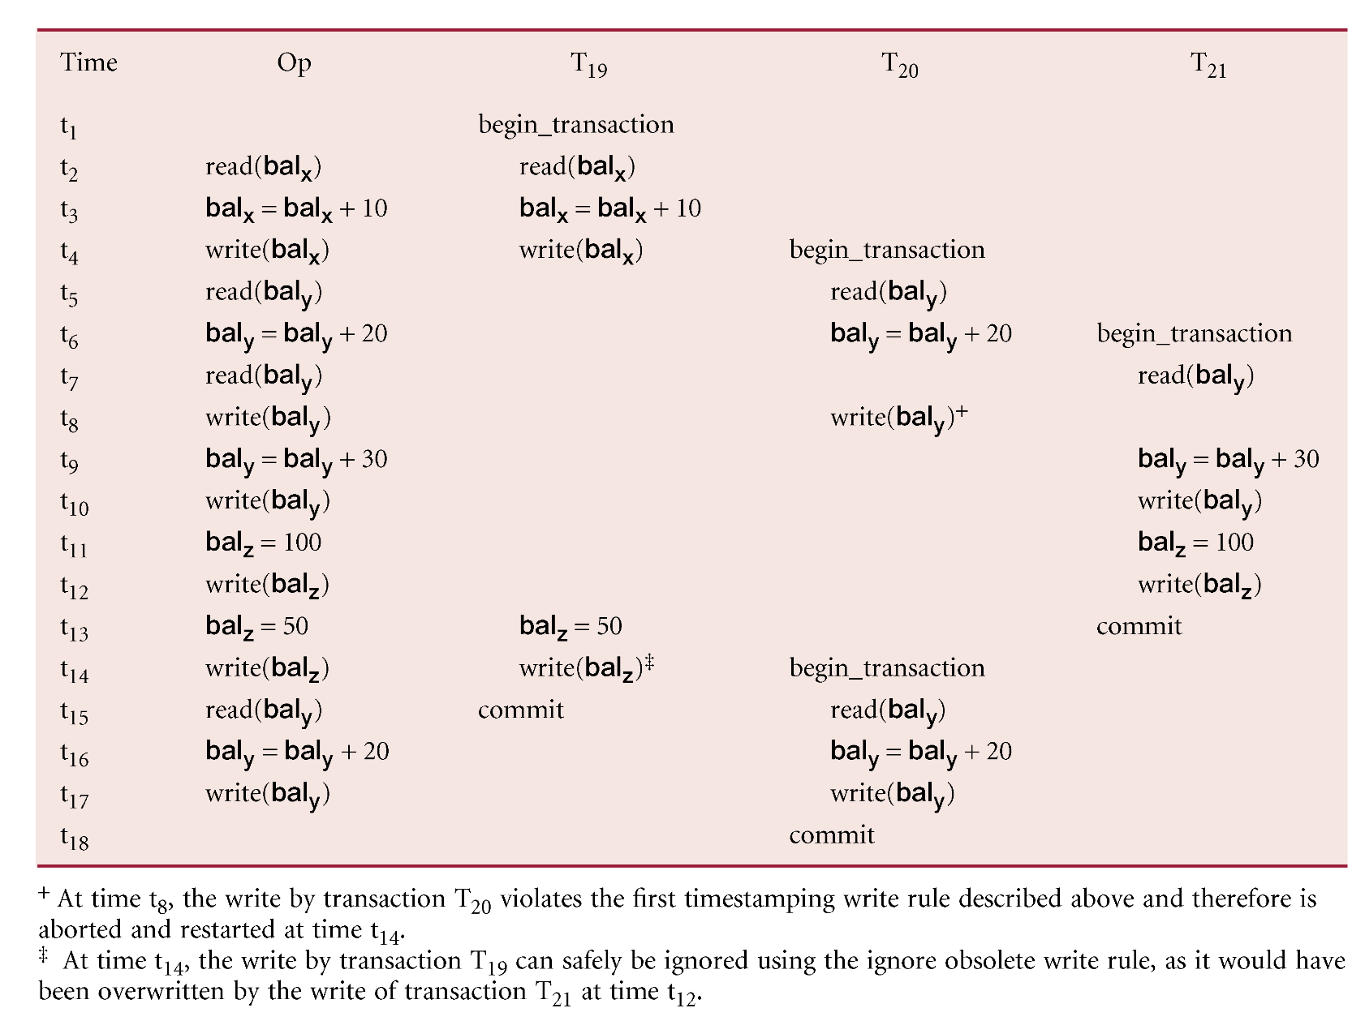
Basic Timestamping Order - Example

Slide 32
Optimistic Techniques
Based on assumption that conflict is rare, it is more efficient to let transactions proceed without delays to ensure serializability.
At commit, a check is made to determine whether conflict has occurred.
If there is a conflict, a transaction must be rolled back and restarted.
Potentially allows greater concurrency than traditional protocols.

Slide 33
Optimistic Techniques
3 phases:
Read Phase: from start of transaction until before commit. The transaction reads the value of all items it needs from the database and stores them locally. Updates applied locally first.
Validation Phase: Checks are performed to ensure serializability are not violated.
Write Phase: after validation (success) the updates are made to a local copy of the database.
Notes:
Validation phase: Read-only transactions check if reads were current. Without interference it is committed. With interference the transaction is aborted. Transactions with updates, determine whether current transaction leaves database in inconsistent state. If inconsistent, then abort.

Slide 34
Granularity of Data Items
Size of data items chosen as unit of protection by concurrency control protocol.
Ranging from coarse to fine:
The entire database.
A file.
A page (or area or database spaced).
A record.
A field value of a record.

Slide 35
Hierarchy of Granularity
Could represent granularity of locks in a hierarchical structure.
Root node represents entire database…Level 0, Level 1s represent files, etc.
When node is locked, all its descendants are also locked.
DBMS should check hierarchical path before granting lock.

Slide 36
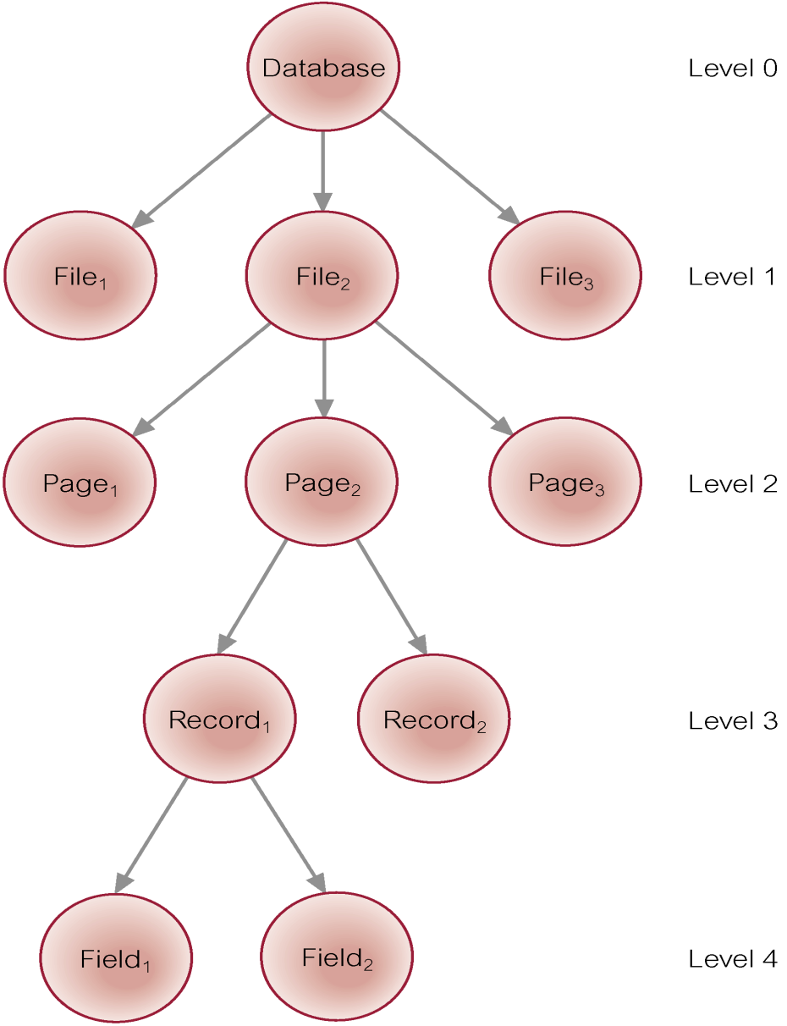
Levels of Locking

Slide 37
Summary
Locking Methods
Livelock/Starvation/Deadlock
Timestamping
Optimistic Techniques
Finish with solution(s) to dining Philosophers

Slide 38
4
3
5
2
1

